Slide 1
Elementary Graph Algorithms
Design and analysis of algorithms

Slide 2
Introduction
Graph and set theory
Graph and computer science

Slide 3
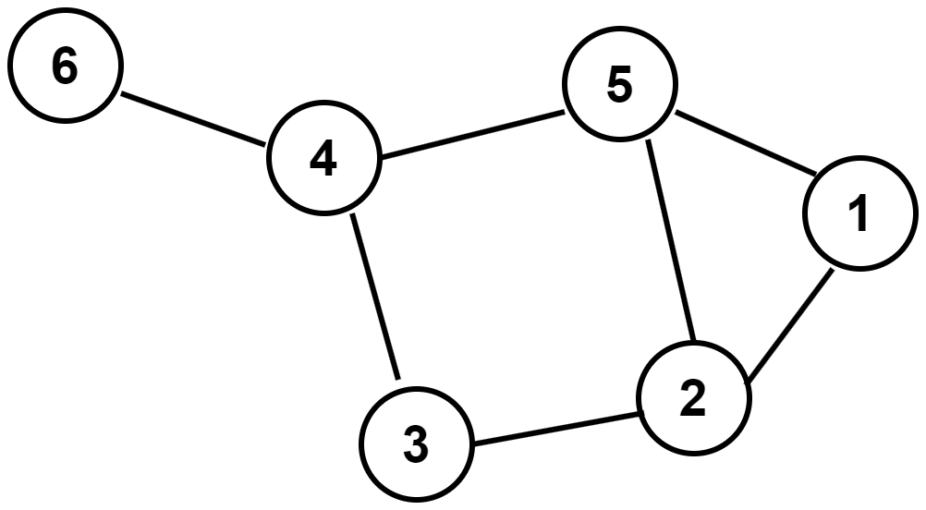
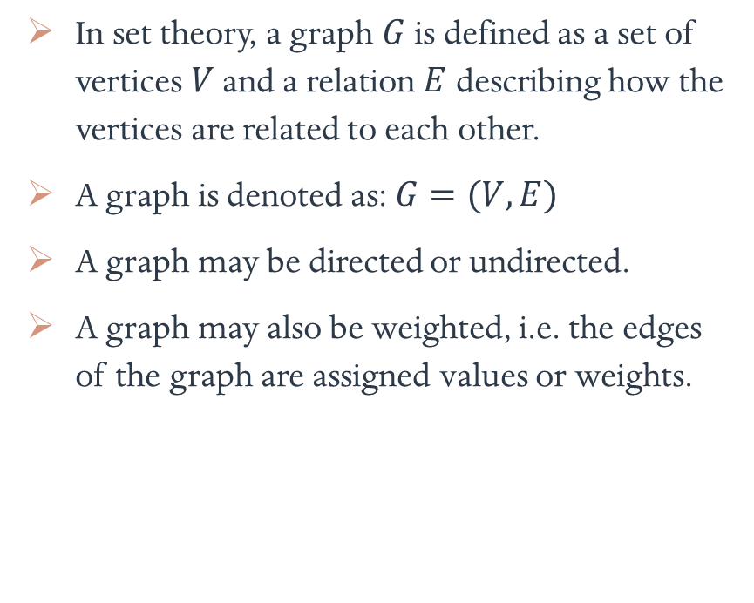
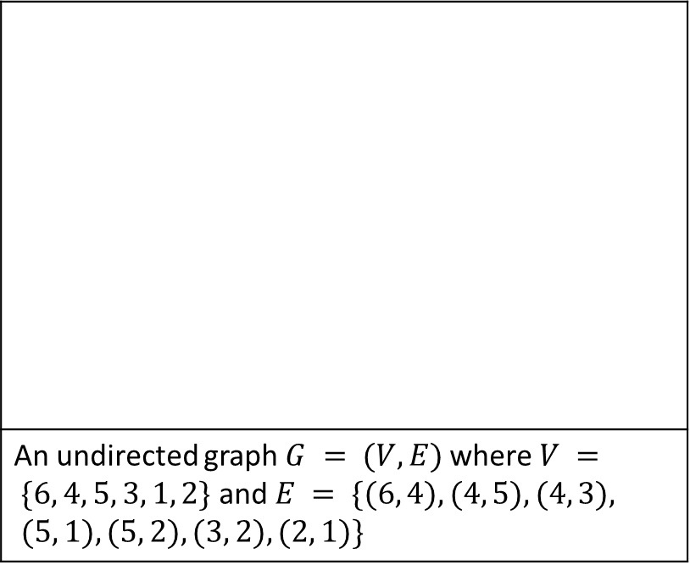
Graph and set theory
In set theory, a graph $G$ is defined as a set of vertices $V$ and a relation $E$ describing how the vertices are related to each other.
A graph is denoted as: $G=(V, E)$
A graph may be directed or undirected.
A graph may also be weighted, i.e. the edges of the graph are assigned values or weights.
An undirected graph $G = (V, E)$where $V = \{6, 4, 5, 3, 1, 2\}$ and $E = \{(6, 4), (4, 5), (4, 3), (5, 1), (5, 2), (3, 2), (2, 1)\}$

Slide 4
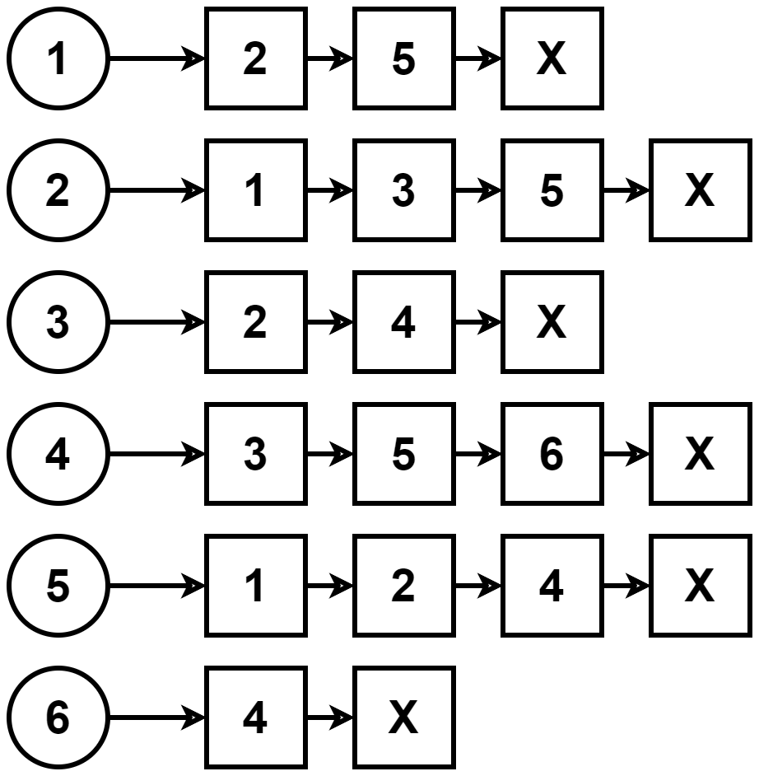
Graph and computer science
In computer science, graph is an abstract data type which is an implementation of a graph in set theory.
One of the ways of implementing graphs is by using linked lists.
The circular nodes are the vertices and the square nodes are the vertices they are connected to.
So the path from a circular node to any of the square node in the adjacent list is an edge.
Implementation using linked lists

Slide 5
Representations of graph
Adjacency list
Adjacency list – time complexity
Adjacency matrix
Adjacency matrix – time complexity

Slide 6
Adjacency list
In this method, linked lists are used to store the adjacent vertices.
A graph consists of a list of vertices. Each vertex in the list, in turn, has a pointer to a list of vertices directly connected to it.
So every vertex in the graph has an edge to each vertex in its adjacency list.
To represent a weighted graph, an additional attribute of weight can be added to each vertex in the adjacency list.
Implementation using adjacency list

Slide 7
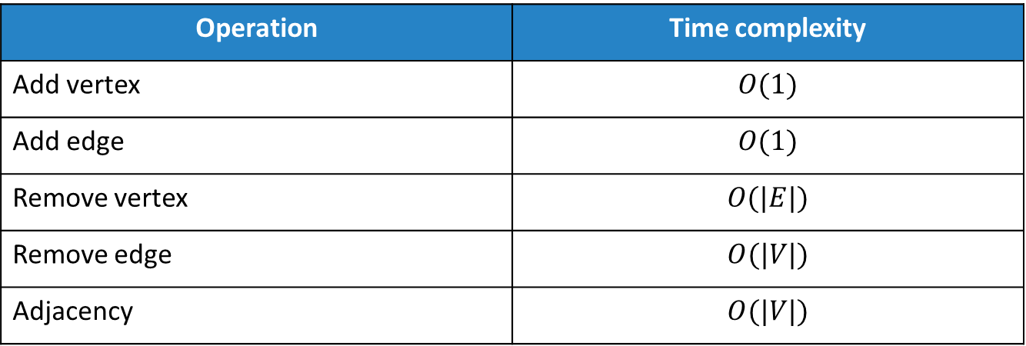
Adjacency list – time complexity
Operation | Time complexity
Add vertex | $$O(1)$$
Add edge | $$O(1)$$
Remove vertex | $$O(|E|)$$
Remove edge | $$O(|V|)$$
Adjacency | $$O(|V|)$$

Slide 8
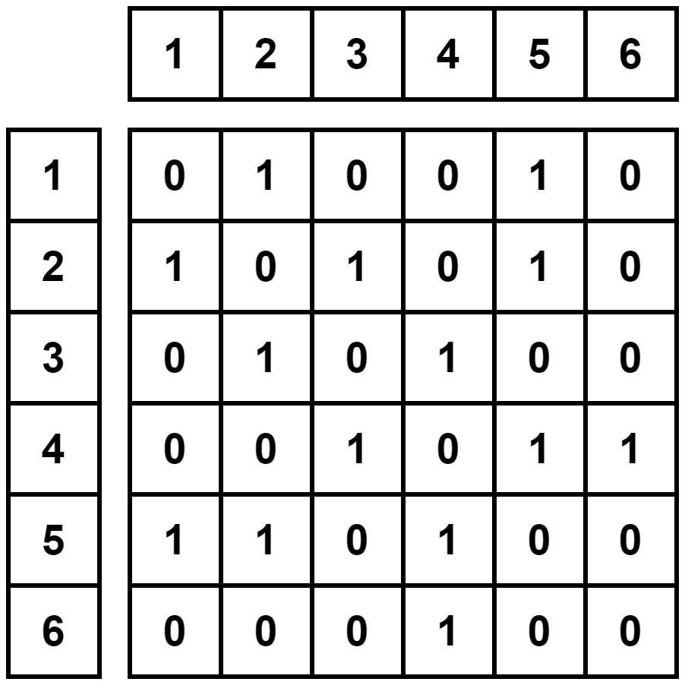
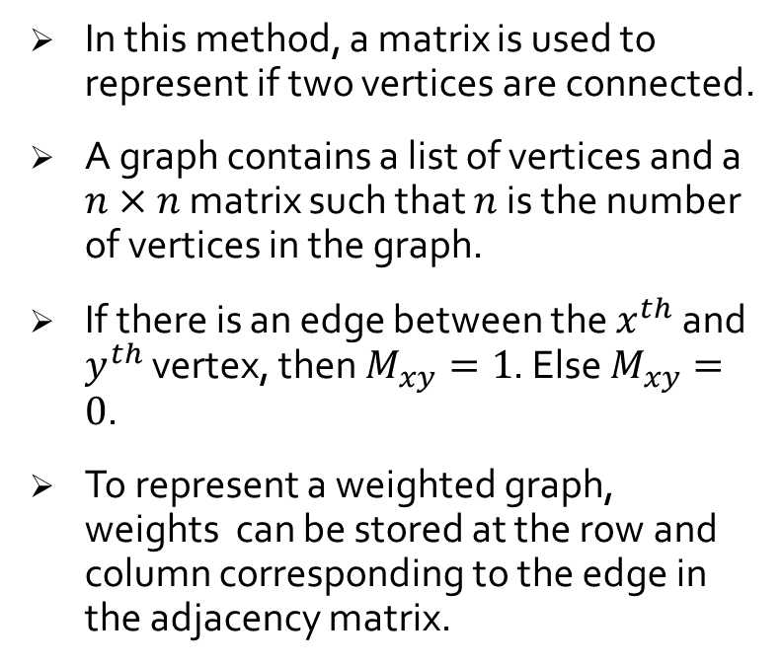
Adjacency matrix
In this method, a matrix is used to represent if two vertices are connected.
A graph contains a list of vertices and a $n×n$ matrix such that $n$ is the number of vertices in the graph.
If there is an edge between the $x^{th}$ and $y^{th}$ vertex, then $M_{xy}=1$. Else $M_{xy}=0$.
To represent a weighted graph, weights can be stored at the row and column corresponding to the edge in the adjacency matrix.
Implementation using adjacency matrix

Slide 9

Adjacency matrix – time complexity
Operation | Time complexity
Add vertex | $$O({|V|}^{2})$$
Add edge | $$O(1)$$
Remove vertex | $$O({\left|V\right|}^{2})$$
Remove edge | $$O(1)$$
Adjacency | $$O(1)$$

Slide 10
Breadth first search
What is BFS?
Attributes
Algorithm
Analysis
Properties
Applications

Slide 11
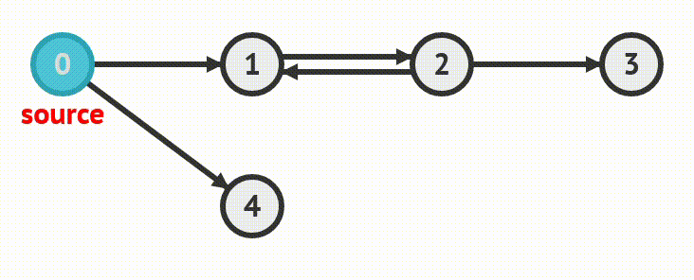
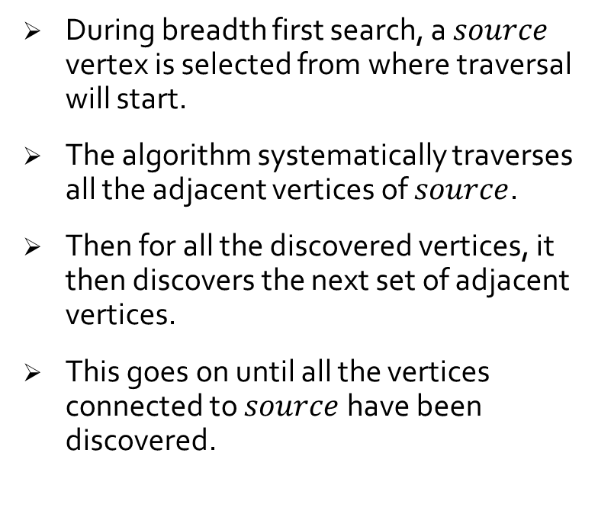
What is BFS?
During breadth first search, a $source$ vertex is selected from where traversal will start.
The algorithm systematically traverses all the adjacent vertices of $source$.
Then for all the discovered vertices, it then discovers the next set of adjacent vertices.
This goes on until all the vertices connected to $source$ have been discovered.
BFS traversal

Slide 12
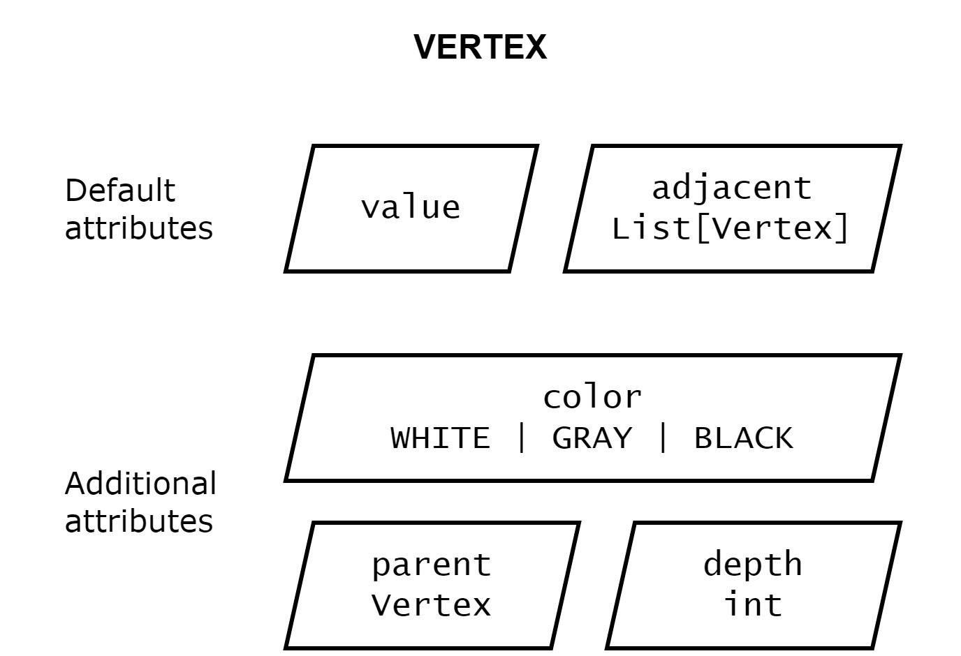
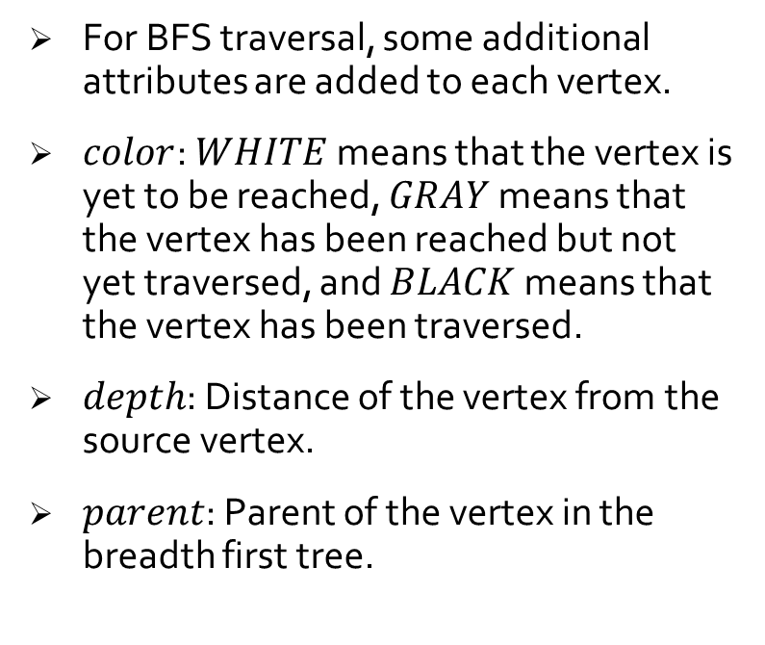
Attributes
For BFS traversal, some additional attributes are added to each vertex.
$color$: $WHITE$ means that the vertex is yet to be reached, $GRAY$ means that the vertex has been reached but not yet traversed, and $BLACK$ means that the vertex has been traversed.
$depth$: Distance of the vertex from the source vertex.
$parent$: Parent of the vertex in the breadth first tree.
BFS vertex attributes

Slide 13
Algorithm
function BFS(graph, source):
# whiten all vertices
for v in graph.vertices:
v.color = WHITE
v.parent = NULL
# traverse source
source.color = GRAY
source.depth = 0
source.parent = NULL
enqueue(source)
# keep dequeuing
while not is_queue_empty():
curr = dequeue()
# traverse nodes adjacent to source
for v in curr.adjacent:
if v.color == WHITE:
v.color = GRAY
v.depth = curr.depth + 1
v.parent = curr
enqueue(v)

Slide 14
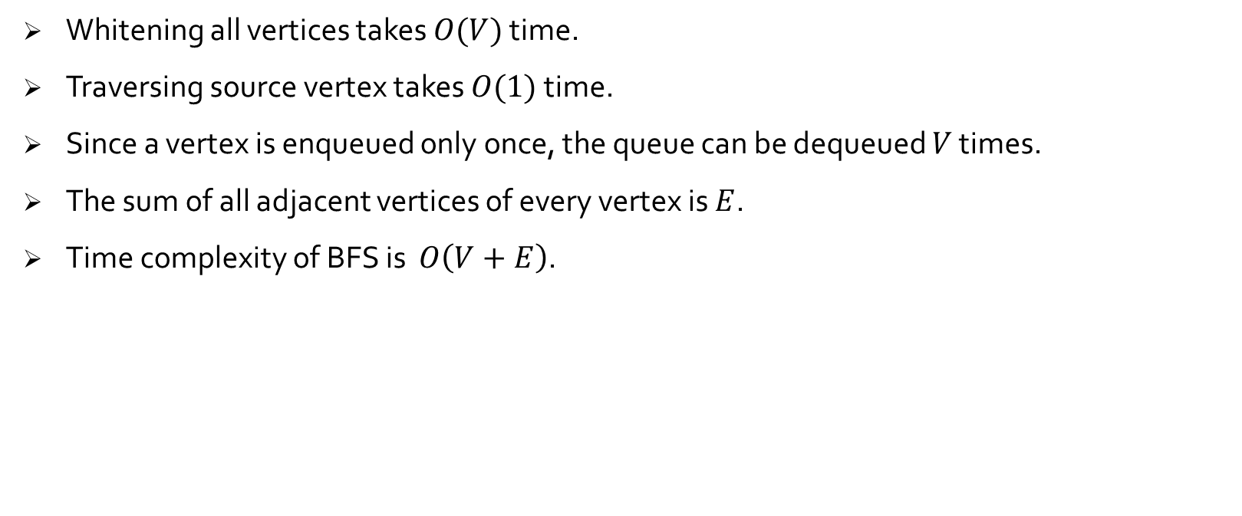
Analysis
Whitening all vertices takes $O(V)$ time.
Traversing source vertex takes $O(1)$ time.
Since a vertex is enqueued only once, the queue can be dequeued $V$ times.
The sum of all adjacent vertices of every vertex is $E$.
Time complexity of BFS is $O\left(V+E\right)$.

Slide 15
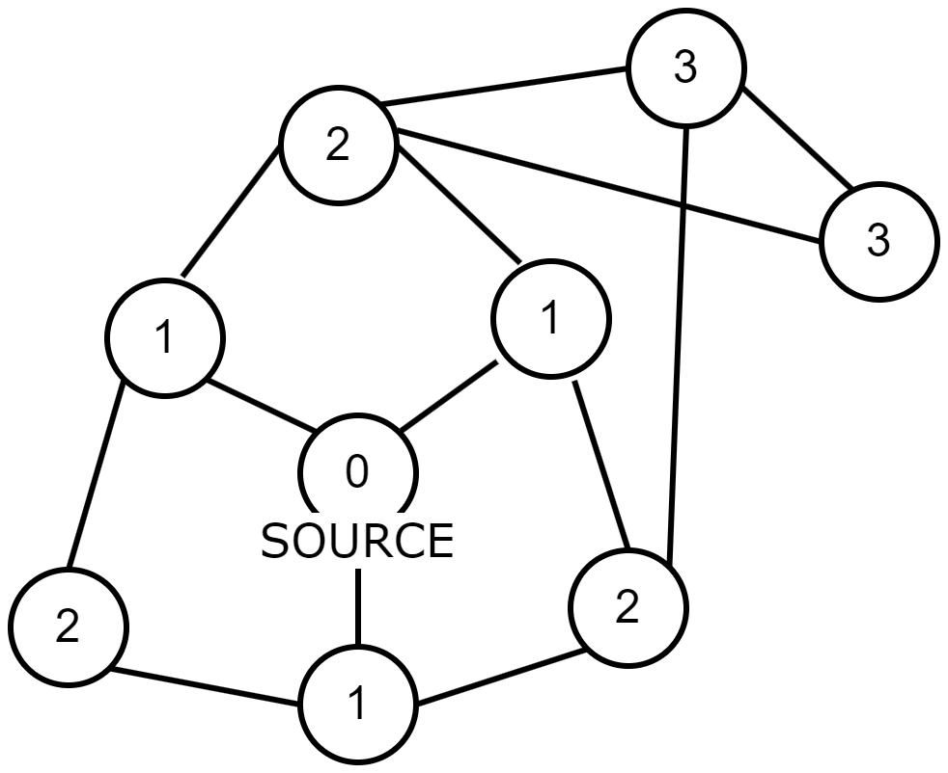
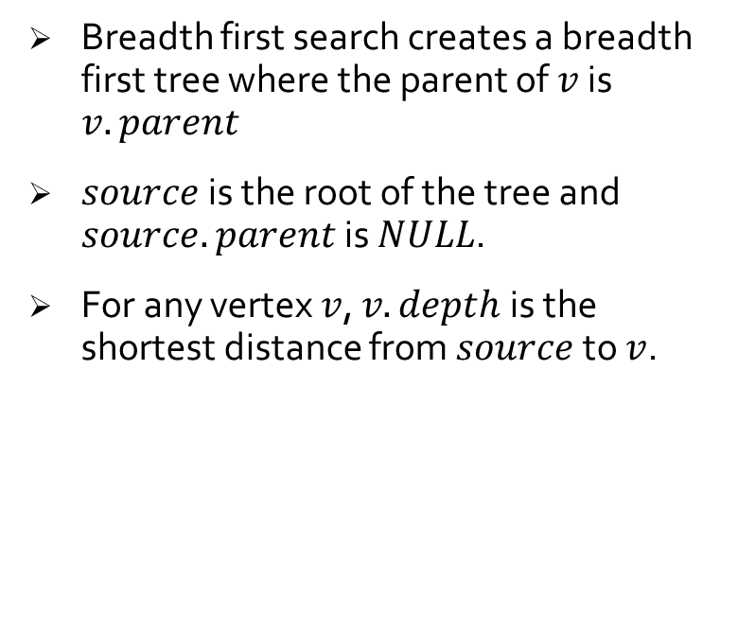
Properties
Breadth first search creates a breadth first tree where the parent of $v$ is $v.parent$
$source$ is the root of the tree and $source.parent$ is $NULL$.
For any vertex $v$, $v.depth$ is the shortest distance from $source$ to $v$.
Shortest path from source

Slide 16
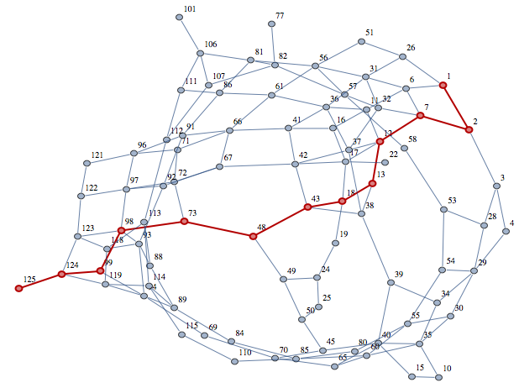
Applications
Prim’s algorithm uses BFS procedure to find minimal spanning tree in weighted graphs.
Dijkstra’s shortest path algorithm also uses BFS procedure for path finding.
Alternatively, it can also be used to find solution to mazes.
BFS traversal is also used to analyze relationships and connections, especially in social networking.
Path finding

Slide 17
Depth first search
What is DFS?
Attributes
Algorithm
Analysis
Properties
Types of edges
White-path theorem
Applications

Slide 18
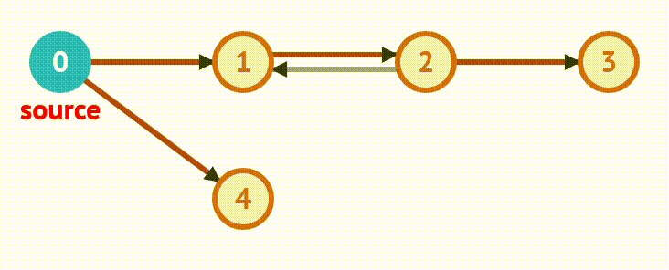
What is DFS?
The aim of depth first search is to traverse deeper vertices first whenever possible.
The algorithm starts with a vertex, keeps discovering deeper vertices until there are no more undiscovered vertices.
Then the same process is repeated for every other undiscovered vertices.
DFS traversal

Slide 19
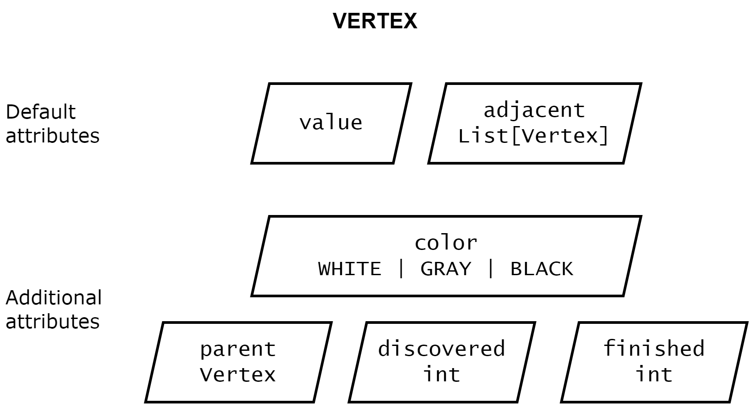
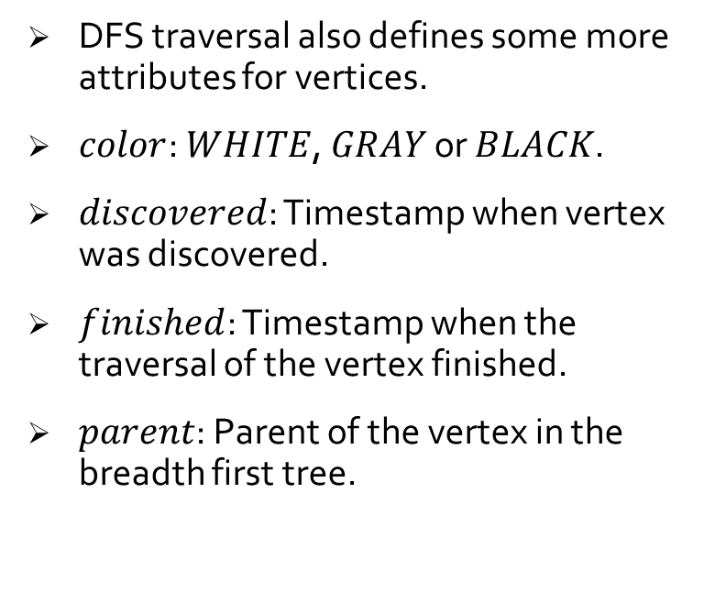
Attributes
DFS traversal also defines some more attributes for vertices.
$color$: $WHITE$, $GRAY$ or $BLACK$.
$discovered$: Timestamp when vertex was discovered.
$finished$: Timestamp when the traversal of the vertex finished.
$parent$: Parent of the vertex in the breadth first tree.
DFS vertex attributes

Slide 20
Algorithm
function DFS(graph):
# whiten all vertices
for v in graph.vertices:
v.color = WHITE
v.parent = NULL
# reset timestamp
timestamp = 0
# visit every vertex
for v in graph.vertices:
if v.color == WHITE:
DFS_VISIT(graph, v)
function DFS_VISIT(vertex):
timestamp += 1
vertex.discovered = timestamp
vertex.color = GRAY
for v in vertex.adjacent:
if v.color == WHITE:
v.parent = vertex
DFS_VISIT(v)
timestamp += 1
vertex.finished = timestamp
vertex.color = BLACK

Slide 21
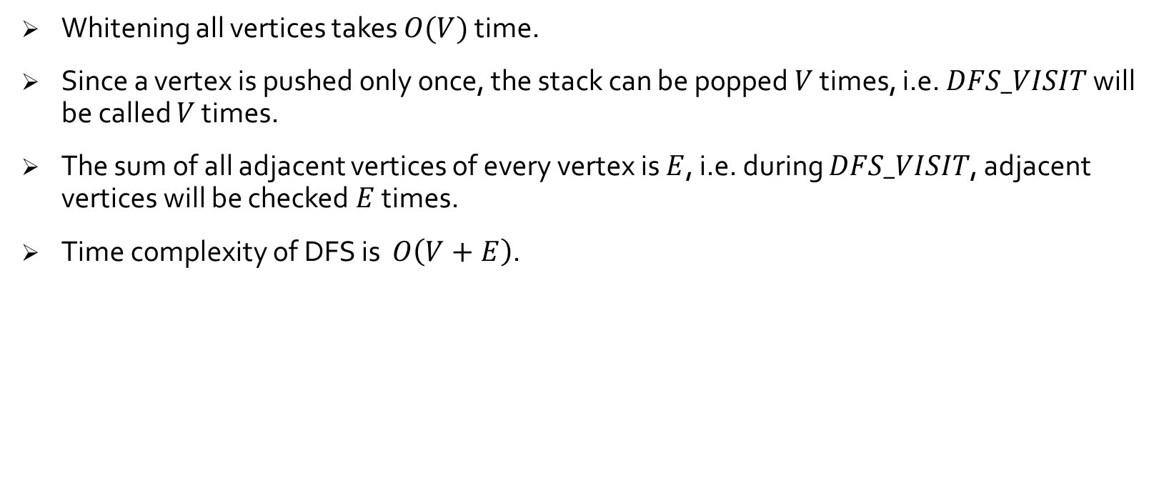
Analysis
Whitening all vertices takes $O(V)$ time.
Since a vertex is pushed only once, the stack can be popped $V$ times, i.e. $DFS_VISIT$ will be called $V$ times.
The sum of all adjacent vertices of every vertex is $E$, i.e. during $DFS_VISIT$, adjacent vertices will be checked $E$ times.
Time complexity of DFS is $O\left(V+E\right)$.

Slide 22
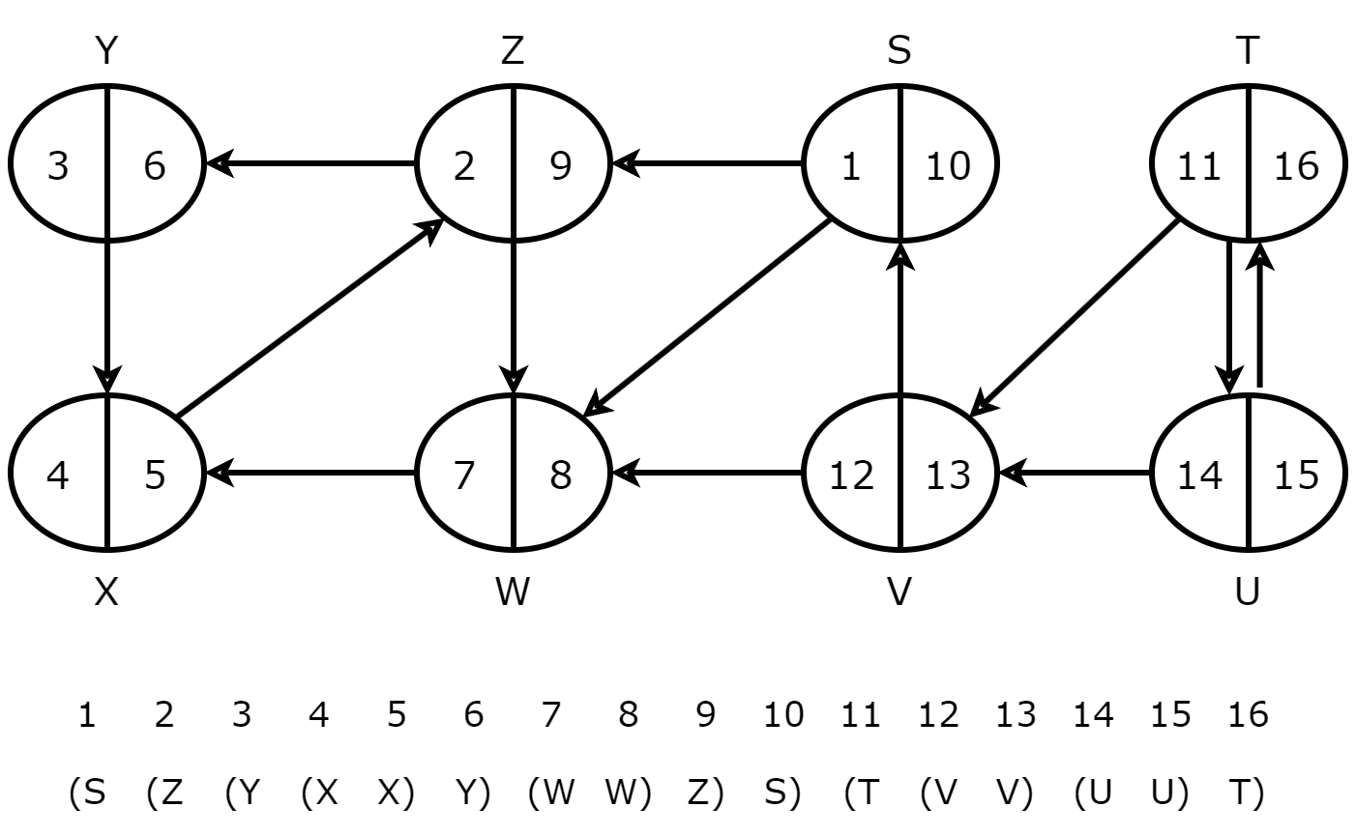
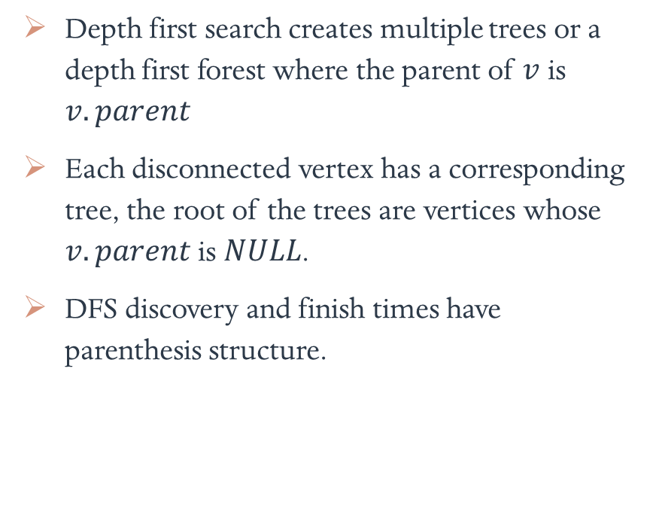
Properties
Depth first search creates multiple trees or a depth first forest where the parent of $v$ is $v.parent$
Each disconnected vertex has a corresponding tree, the root of the trees are vertices whose $v.parent$ is $NULL$.
DFS discovery and finish times have parenthesis structure.
Parenthesis structure

Slide 23
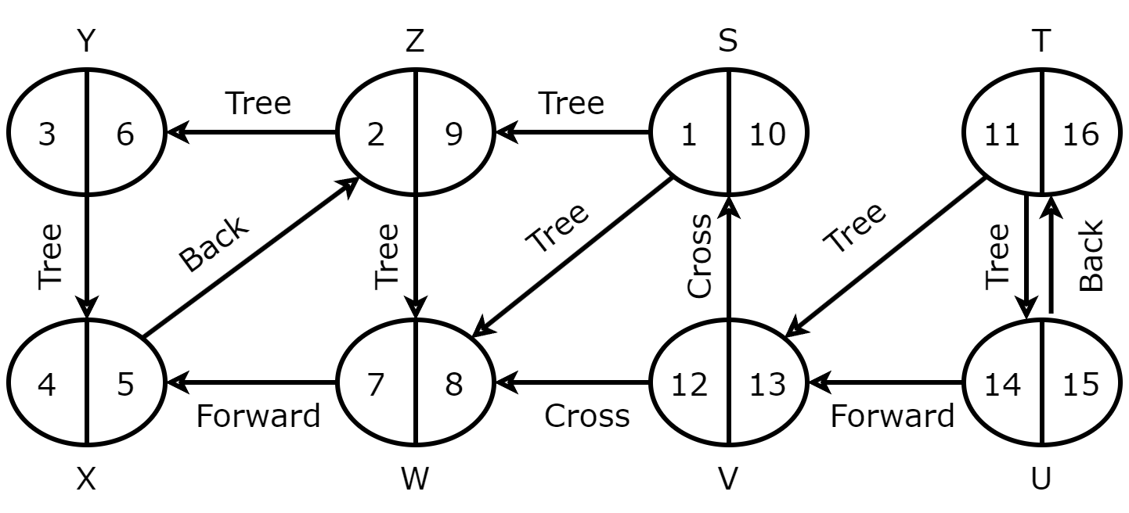
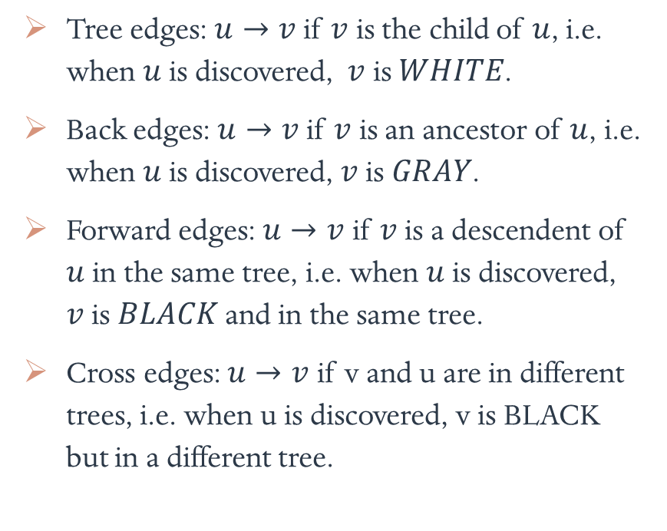
Types of edges
Tree edges: $u→v$ if $v$ is the child of $u$, i.e. when $u$ is discovered, $v$ is $WHITE$.
Back edges: $u→v$ if $v$ is an ancestor of $u$, i.e. when $u$ is discovered, $v$ is $GRAY$.
Forward edges: $u→v$ if $v$ is a descendent of $u$ in the same tree, i.e. when $u$ is discovered, $v$ is $BLACK$ and in the same tree.
Cross edges: $u→v$ if v and u are in different trees, i.e. when u is discovered, v is BLACK but in a different tree.
Types of edges

Slide 24
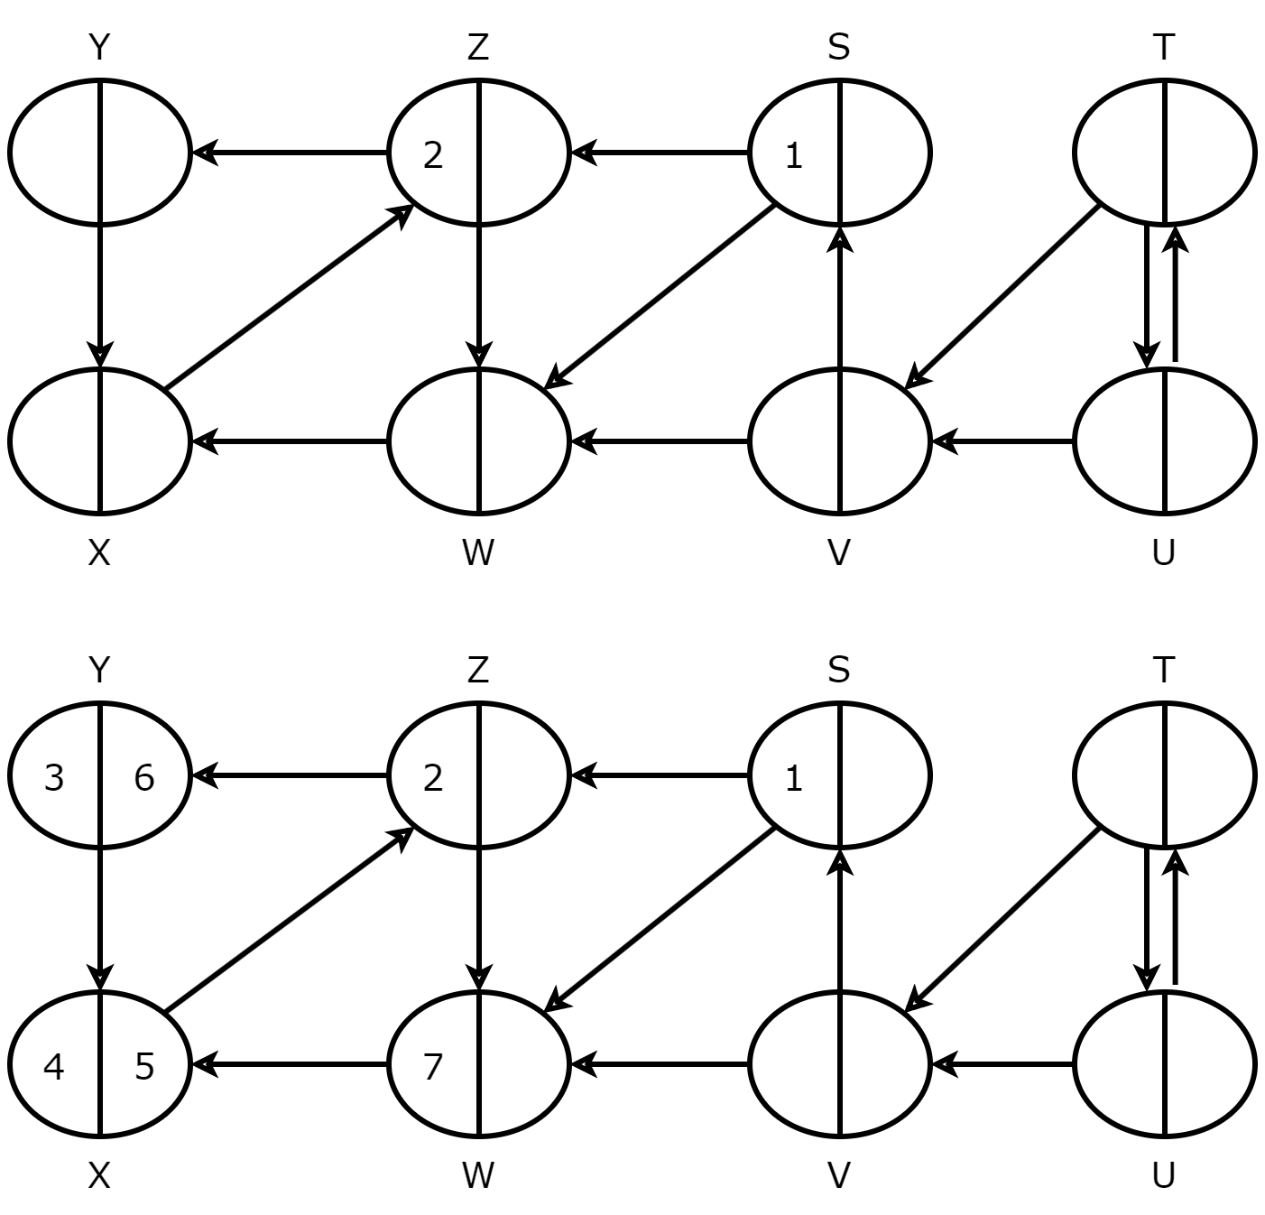
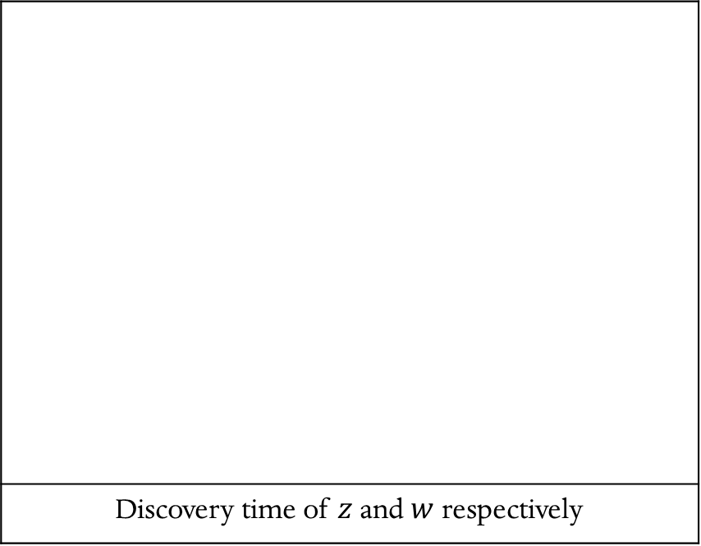
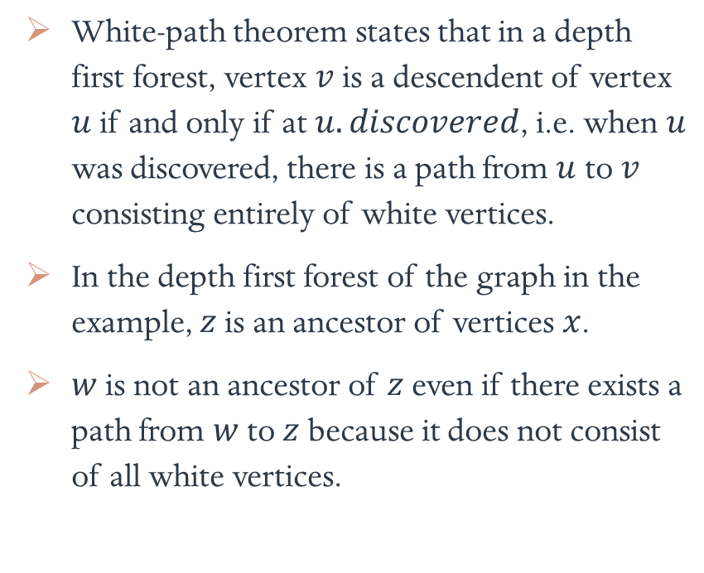
White-path theorem
White-path theorem states that in a depth first forest, vertex $v$ is a descendent of vertex $u$ if and only if at $u.discovered$, i.e. when $u$ was discovered, there is a path from $u$ to $v$ consisting entirely of white vertices.
In the depth first forest of the graph in the example, $z$ is an ancestor of vertices $x$.
$w$ is not an ancestor of $z$ even if there exists a path from $w$ to $z$ because it does not consist of all white vertices.
Discovery time of $z$ and $w$ respectively

Slide 25
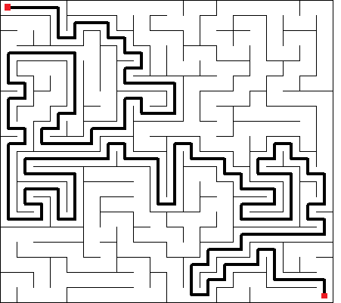
Applications
DFS provides key information about the structure of the graph, e.g. if the graph is cyclic in nature.
DFS can also be used to identify connected components in a graph.
DFS is used in topological sort and topological sort is used to resolve dependencies in complex environments.
It can also be used to solve mazes.
Maze solving

Slide 26
Topological sort
What is topological sort?
Algorithm
Analysis
Applications

Slide 27
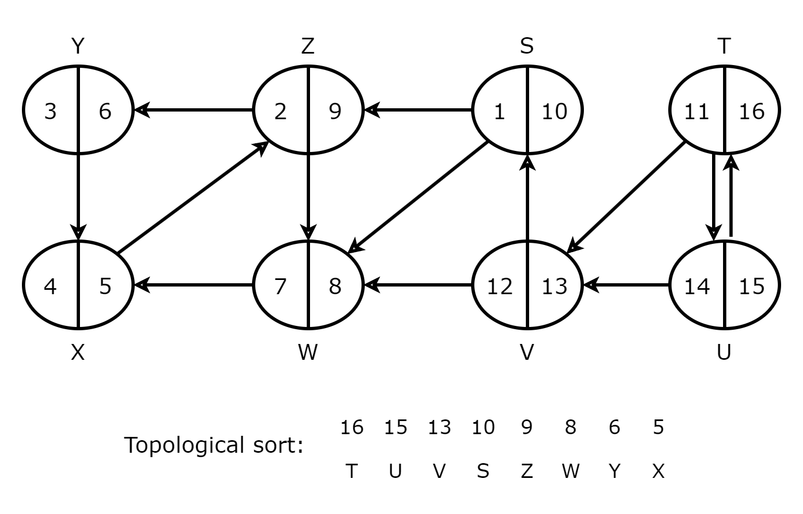
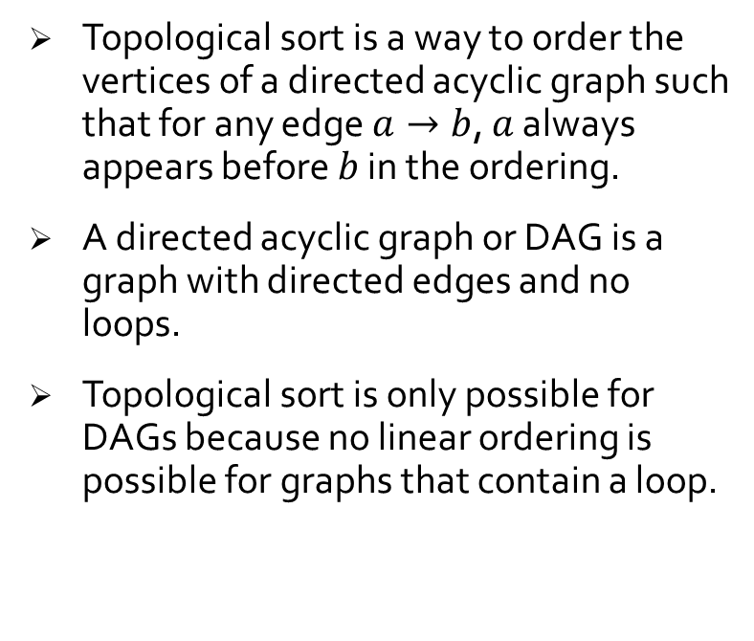
What is topological sort?
Topological sort is a way to order the vertices of a directed acyclic graph such that for any edge $a→b$, $a$ always appears before $b$ in the ordering.
A directed acyclic graph or DAG is a graph with directed edges and no loops.
Topological sort is only possible for DAGs because no linear ordering is possible for graphs that contain a loop.
Topological sort

Slide 28
Algorithm
function TOPOLOGICAL_SORT(graph):
stack = []
timestamp = 0
# whiten all vertices
for v in graph.vertices:
v.color = WHITE
# visit every vertex
for v in graph.vertices:
if v.color == WHITE:
TOPOLOGICAL_VISIT(v, stack)
function TOPOLOGICAL_VISIT(vertex, stack):
# increase timestamp
timestamp += 1
vertex.color = GRAY
for v in vertex.adjacent:
if v.color == WHITE:
TOPOLOGICAL_VISIT(v)
timestamp += 1
vertex.finished = timestamp
stack.push_front(vertex)
vertex.color = BLACK

Slide 29
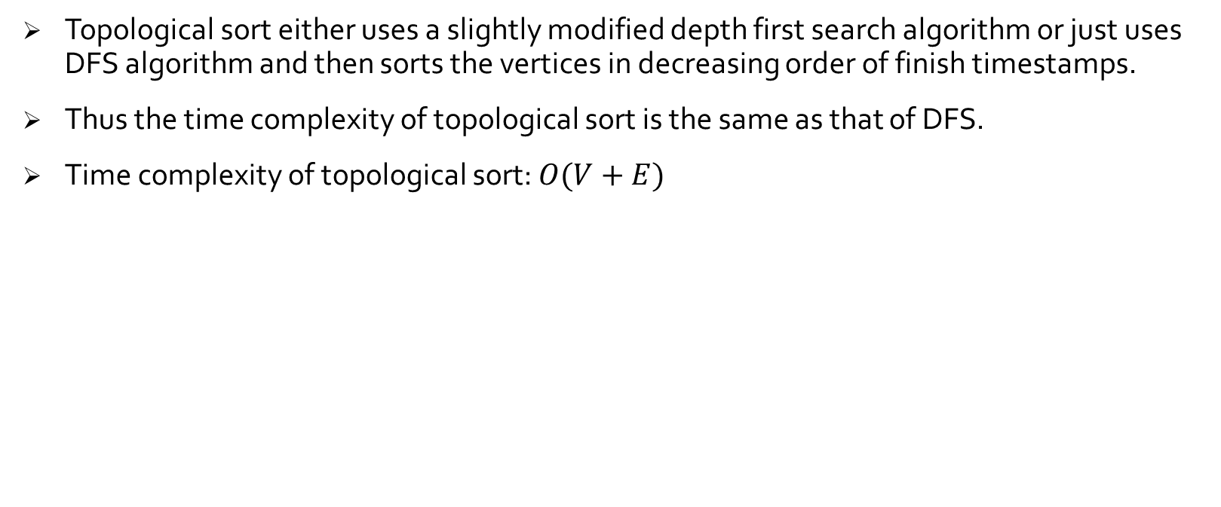
Analysis
Topological sort either uses a slightly modified depth first search algorithm or just uses DFS algorithm and then sorts the vertices in decreasing order of finish timestamps.
Thus the time complexity of topological sort is the same as that of DFS.
Time complexity of topological sort: $O(V+E)$

Slide 30

Applications
Software compilation: Compilers use topological sort to find the order in which to compile source files according to their dependencies.
Task scheduling: Similarly, CPU schedulers also use this sorting technique to find the order of tasks according to their dependencies.
Project planning: It can be also useful while planning a complex projects.
Scheduling

Slide 31
Strongly connected components
What is a strongly connected component?
Algorithm
Analysis

Slide 32
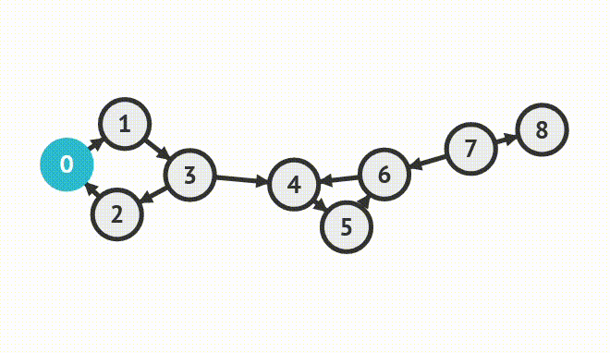
What is strongly connected component?
A strongly connected component or SCC of a directed graph is a maximal set of vertices where each vertex is connected to every other vertex.
SCCs can be used to divide a complex graph into multiple sub-graphs which can be then worked upon individually.
After the individual operations are complete, they can be then merged together.
Kosaraju’s algorithm

Slide 33
Algorithm
function STRONGLY_CONNECTED_COMPONENTS(graph):
DFS(graph)
TOPOLOGICAL_SORT(graph)
transpose = TRANSPOSE(graph)
# each tree in the forest is a strongly
# connected component
DFS(transpose)
forest = transpose.forest
return TRANSPOSE(forest)
function TRANSPOSE(graph):
transpose = Graph()
# reverse every edge direction
for v in graph.vertices:
for u in v.adjacent:
graph.vertex[u] = v
return transpose

Slide 34
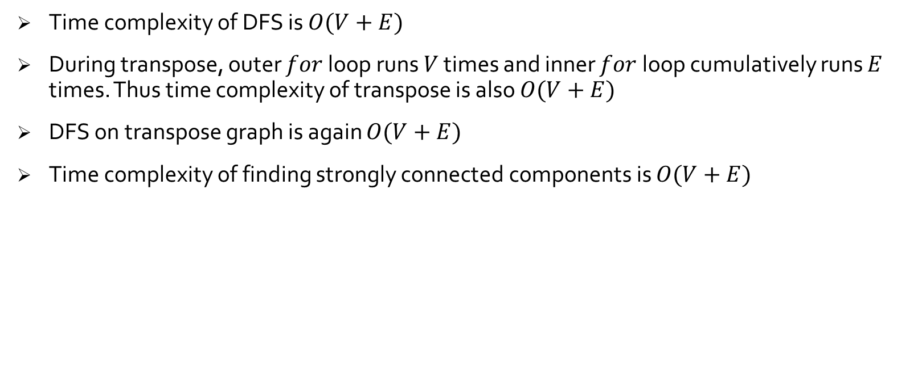
Analysis
Time complexity of DFS is $O(V+E)$
During transpose, outer $for$ loop runs $V$ times and inner $for$ loop cumulatively runs $E$ times. Thus time complexity of transpose is also $O(V+E)$
DFS on transpose graph is again $O(V+E)$
Time complexity of finding strongly connected components is $O(V+E)$

Slide 35
Conclusion
Applications of graph: I
Applications of graph: II

Slide 36
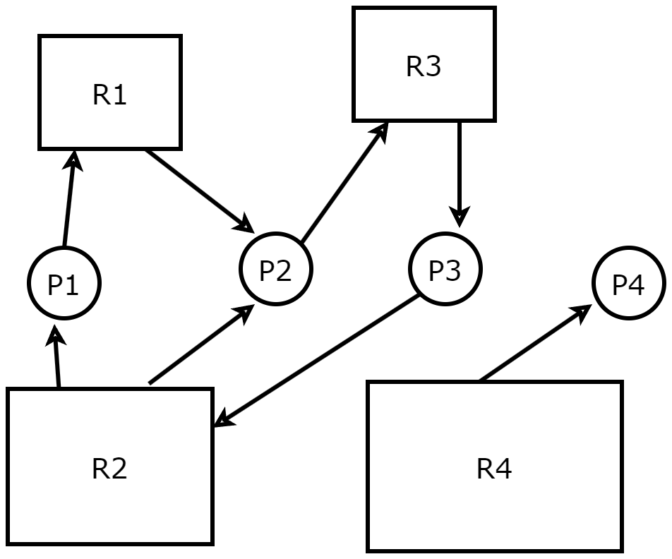
Applications of graph: I
Maps: Locations in a map are vertices and the paths connecting them are edges.
Social media: All the users are vertices and if two users are friends there is an edge between them.
Resource allocation graphs: In operating systems, processes and resources are vertices and an edge represents if an user is using a resource.
Resource allocation graph

Slide 37
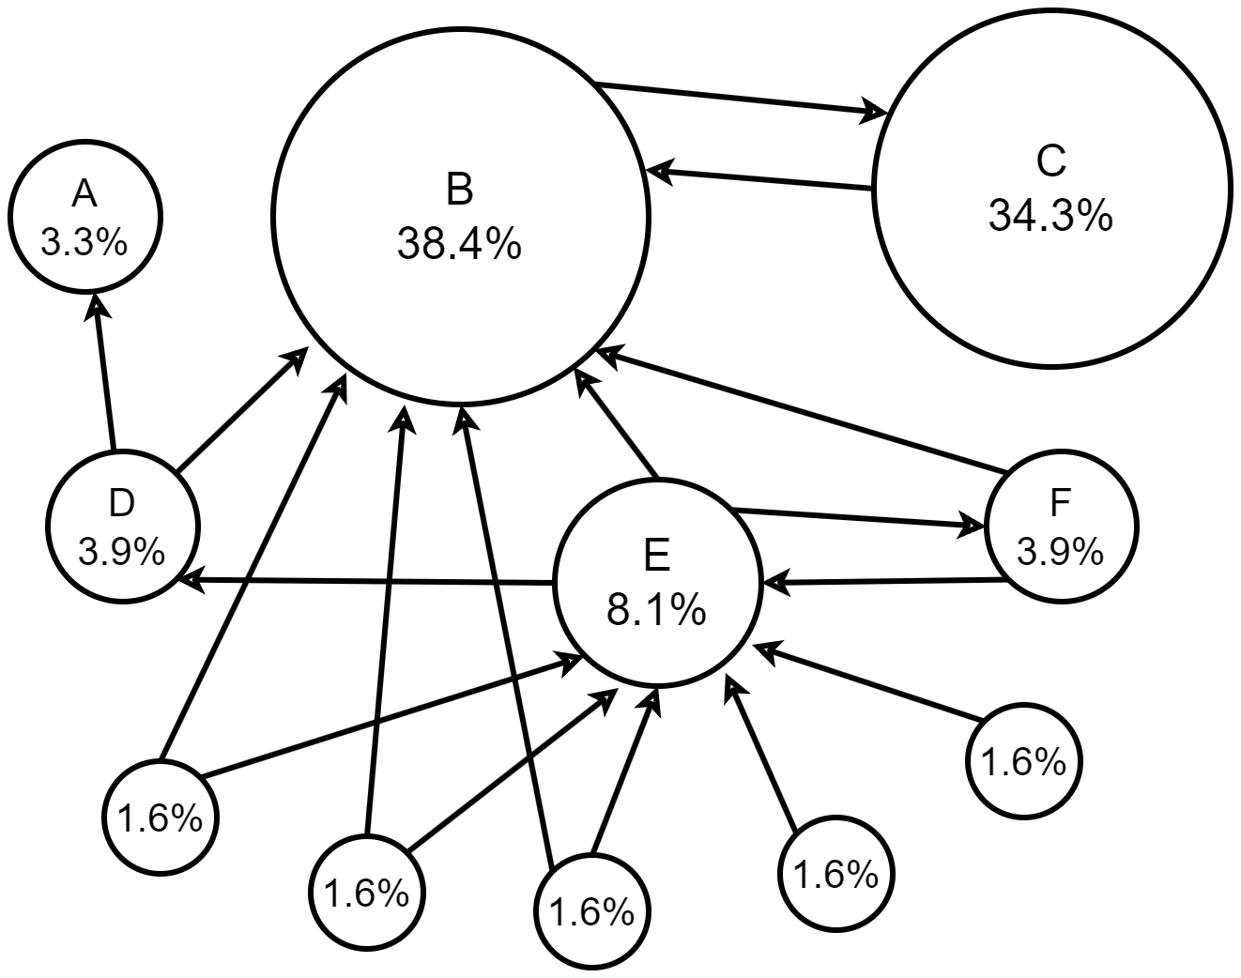
Applications of graph: II
Web: All the pages are vertices and if two pages are linked an edge is created between the two pages.
Google uses graph algorithms to find the popularity of webpages. The popularity of a page is decided on the basis of the number and popularity of the pages which have links to it.
Graphs are also used to solve many real life problems, like path finding and scheduling.
Google’s Page Ranking algorithm

Slide 38
Bibliography
Introduction to Algorithms – Cormen
https://visualgo.net
https://www.iacr.org
https://en.wikipedia.org
https://codinginfinite.com
https://www.researchgate.net
https://www.geeksforgeeks.org
https://courses.cs.washington.edu

Slide 39
THANK YOU

